Slide 1

SIR C R REDDY COLLEGE FOR WOMEN
(Affiliated to Adikavi Nannaya University , Rajamahendravaram) Vatluru(PO), Eluru
III BSC VI SEMESTER ( ELECTRONICS)
AUTOMATIC SMOKE DETECTOR ALARM
MQ-135 SMOKE SENSOR & ARDUINO
Internet Of Things (IOT)
SUBMITTED BY
Y.Madhu Shalini(203307137428)
Y.A.L. Sujatha(203307137426)
N.Thanusha Rani(203307137411)

Slide 2
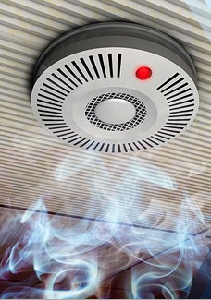

AUTOMATIC SMOKE DETECTOR ALARM MQ-135 SMOKE SENSOR & ARDUINO

Slide 3
SCOPE:
Introduction
Abstract
circuit diagram
Components
Connections
Applications
advantages & disadvantages
conclusion

Slide 4
INTRODUCTION:
In our daily life, we come across many incidents that fire accidents in industries or in any hospitals. But we don’t focus much on how this gas or smoke or fire was detected. Here’s the project which describes about how the smoke is being detected and how it performs operations through logistics available in market in a scientific procedure. In this project the detection of gases like smoke, butane , propane, alcohol can be detected by a sensor named MQ-135 smoke sensor. The smoke sensor we used is the MQ-135 sensor. Smoke Detectors are very useful in detecting smoke or fire in buildings, and so are the important safety parameters.

Slide 5
Abstract
The objective of the project “ AUTOMATIC SMOKE DETECTOR ALARM MQ-135 SMOKE SENSOR & ARDUINO “ is a fire protection device that automatically detects smoke and gives us warning through led on and starts alarming with a buzzer.
A smoke detector is an electronic fire-protection device that automatically senses the presence of smoke, indication of fire, and Sounds a warming to building occupants.

Slide 6
Components:
HARDWARE REQUIREMENTS:
Jumper wires
Arduino UNO
Buzzer
Resistor 1k & 100k
Smoke sensor
Bread board
LED’S

Slide 7
SOFTWARE REQUIREMENTS:
Window 10 operating system
Arduino IDE 1.8.5

Slide 8

CIRCUIT DIAGRAM :

Slide 9
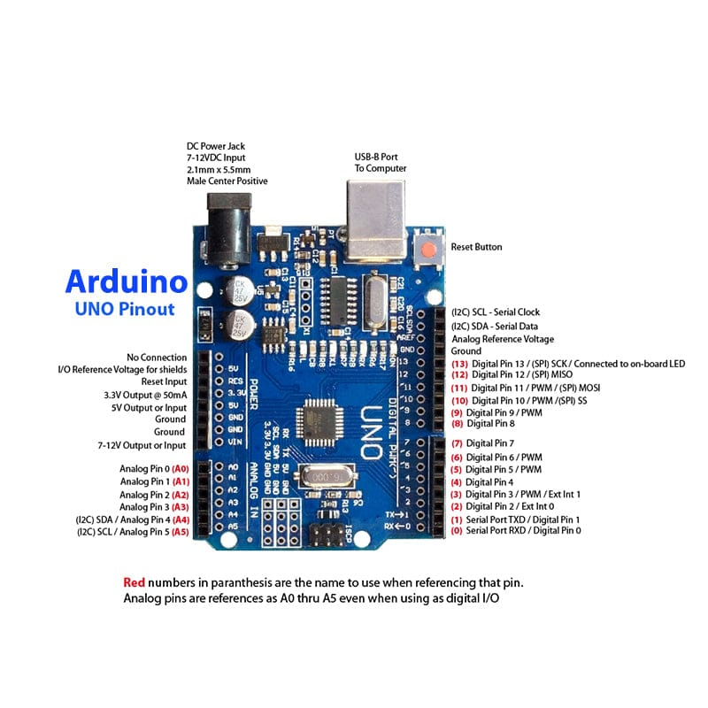
Arduino uNO

Slide 10
Arduino UNO
Arduino is an open- source electronics platform based on easy- to- use hardware and software.
Arduino boards are able to read input-light on a sensor, activating a motor, turning on an led,publishing something online.
You can tell your board what to do by sending a set of instructions to the microcontroller on the board.
To do so you use the arduino programming language (based on wiring),and the arduino software (ide).Based on processing.

Slide 11
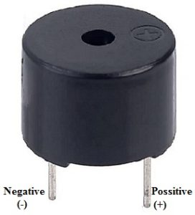
BUZZER :
A buzzer or beeper is a audio signalling device. Which may be mechanical, electrochemical, or piezoelectric typical uses of buzzers and beepers include alarms,timers, and confirmation of user input such as a mouse click or keystroke.
APPLICATIONS OF BUZZER:
1. Alarms
2. Automobiles
3. Warning devices
4. Electric field

Slide 12
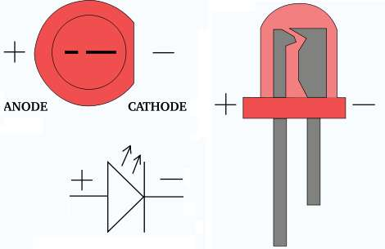
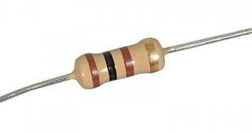

LED 100 ohm resistor 1k resistor

Slide 13
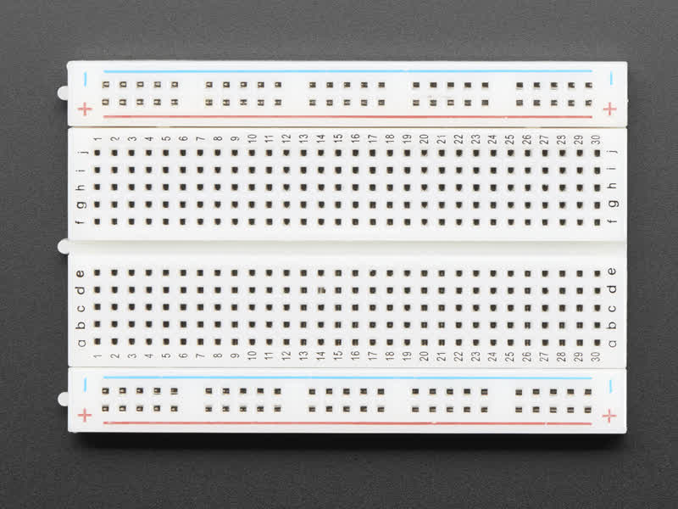
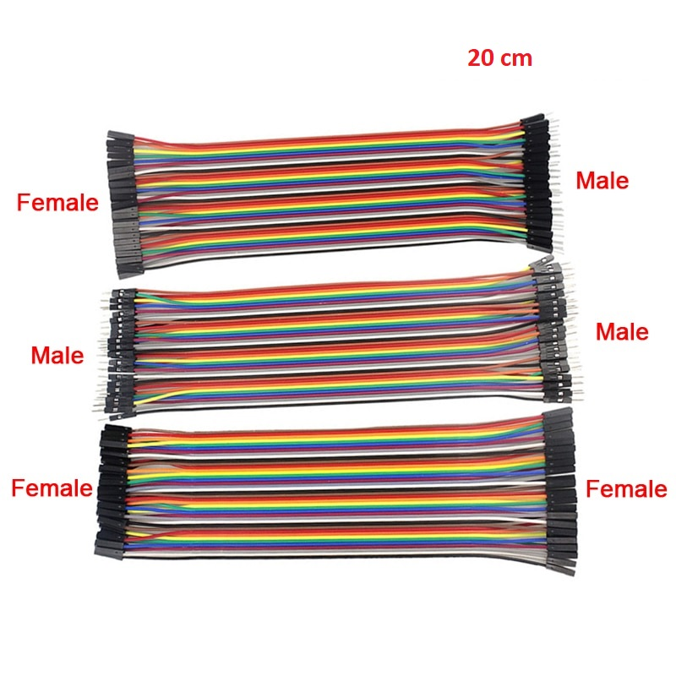
Jumper wires bread board

Slide 14
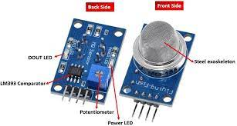
Smoke sensor:
The MQ-135 gas sensor module is a device that is used for sensing a range of gases, including ammonia (NH3), sulfur dioxide (SO2), and carbon monoxide (CO).
An MQ-135 air quality sensor is one type of MQ gas sensor used to detect, measure, and monitor a wide range of gases present in air like ammonia, alcohol, benzene, smoke, carbon dioxide, etc. It operates at a 5V supply with 150 ma consumption.

Slide 15
CONNECTION :
ARDUINO BUZZER LED
Pin 0 (+ ve ) pin
Pin 1 (+ ve ) pin of LED 1
Pin 2 (+ve ) pin of LED 2
Gnd (-ve) pins of LED’s with resistance
ARDUINO BUZZER
Gnd GND pins of a Buzzer with resistance
ARDUINO MQ-135 (SMOKE SENSOR)
pin A0 pin A0
5v VCC pin
Gnd Gnd

Slide 16
INPUT: Circuit connection and upload the code.
OUTPUT: Detects smoke and gives us warning through led on and alarming with a buzzer.

Slide 17


Slide 18
APPLICATIONS:
Works as a portable air pollution detector.
Used as an industrial air pollution detector.
Used as a domestic air pollution detector.
Used in the detection of excess or leakage of gases like Nitrogen oxide, ammonia, alcohol, smoke and sulfide.
Used as air quality monitors.
Used in air quality equipment for offices and buildings.

Slide 19
ADVANTAGES :
Smoke alarm system installed in your home or building is that it gives you peace of mind.
A fast response can minimize damage.
Sensitivity.
Smoke sensor portable.
DISADVANTAGES:
Installing a smoke alarm system is the cost involved.
Depending on the plan selected.
It is very sensitive , which can lead to false alarm.
These smoke sensors are used up to only a period of ten years.

Slide 20
CONCLUSION:
A sound quality fire alarm system may provide peace of mind knowing that your home or building is protected from fires with early warning notifications but there are certain drawbacks too, such as cost and potential false alarms due to faulty sensors.

Slide 21
THANK YOU

